Slide 1

Machine Learning Fundamentals

Slide 2
Machine Learning Foundations
scikit-learn Intro
ML Workflow
Types of ML
Traditional vs ML
What is ML?

Slide 3
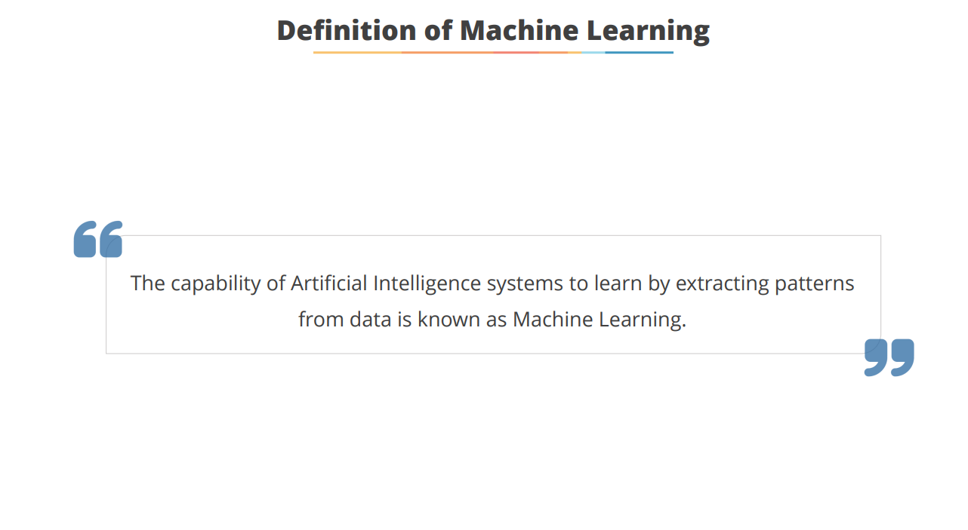
Machine Learning Journey
Initial Understanding
Practical Application
Learning Types
Model Building
Hands-on Exposure
Basic ML concepts
Exploring supervised, unsupervised, reinforcement
Understanding the workflow
Applying ML to business projects
Using Python libraries

Slide 4
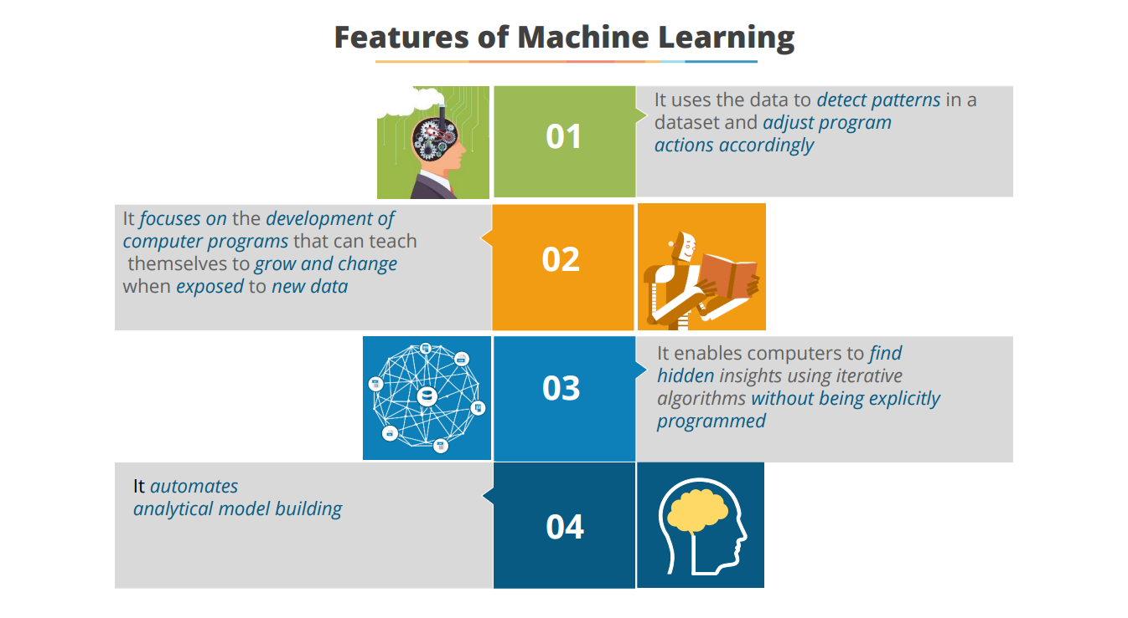

Slide 5
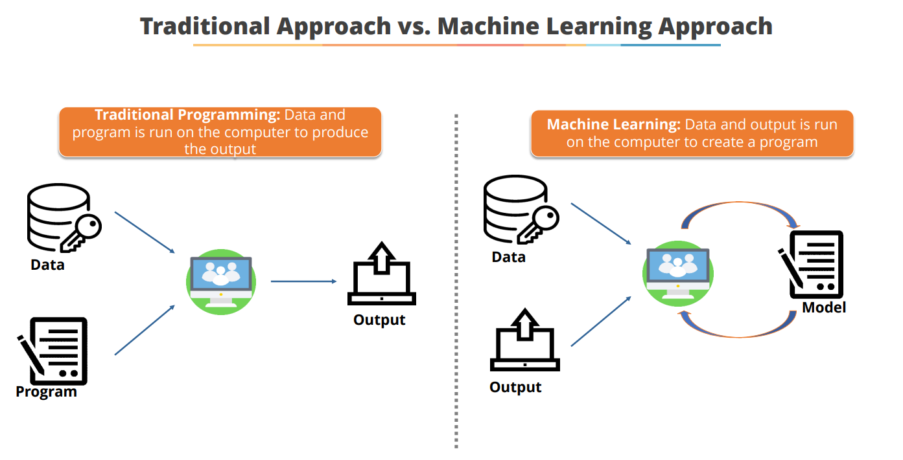

Slide 6
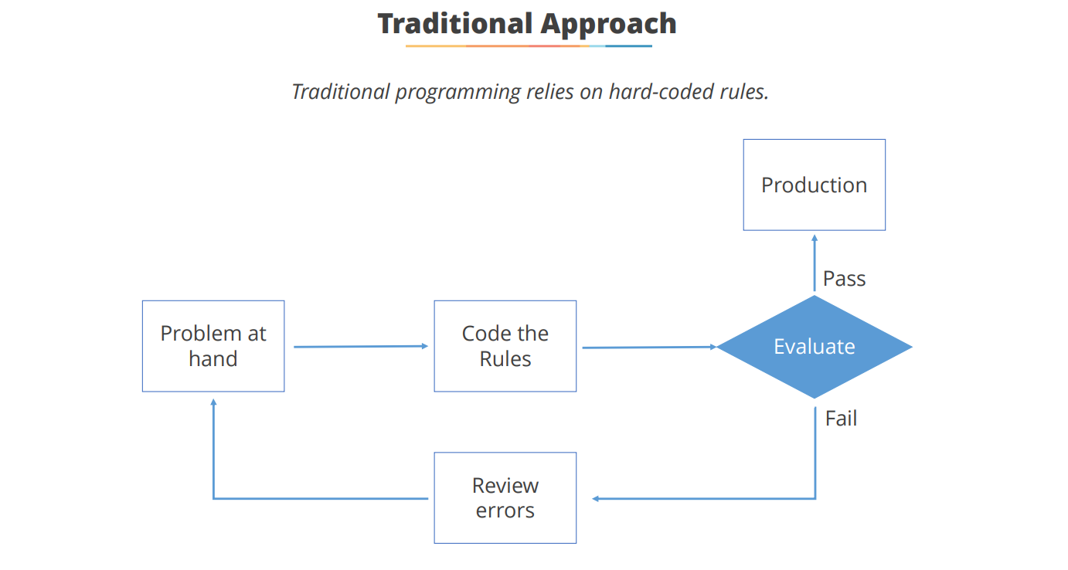

Slide 7
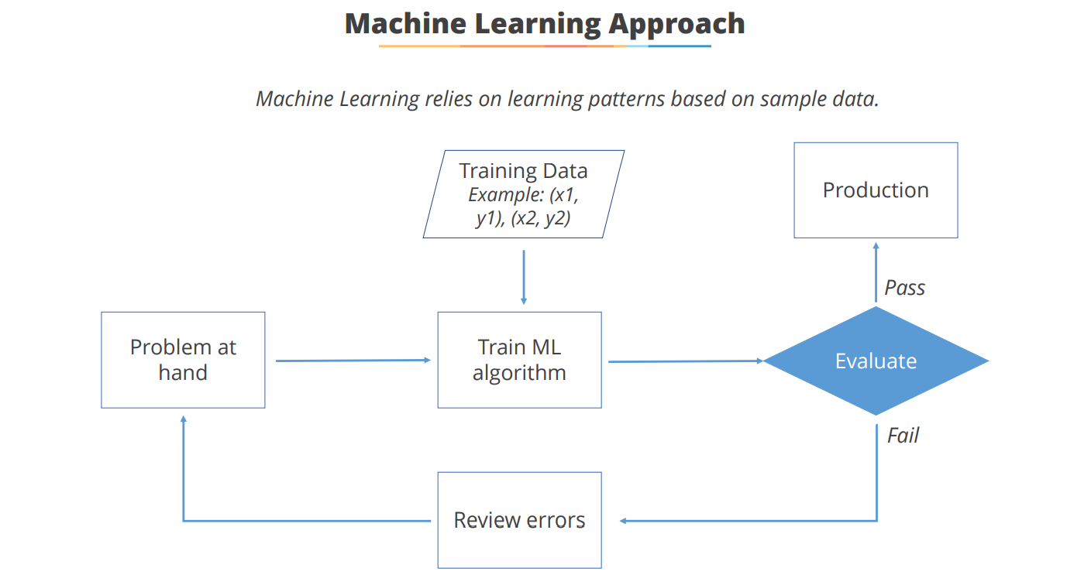

Slide 8
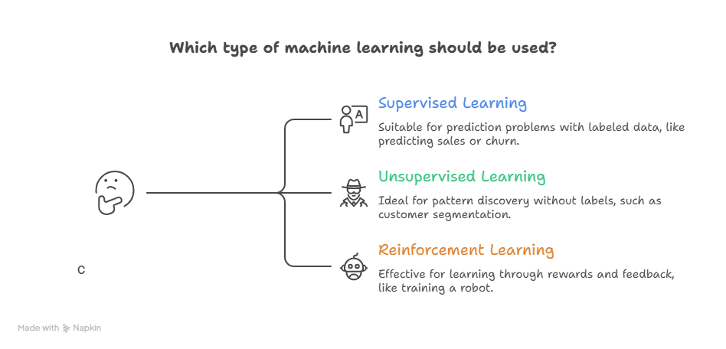

Slide 9
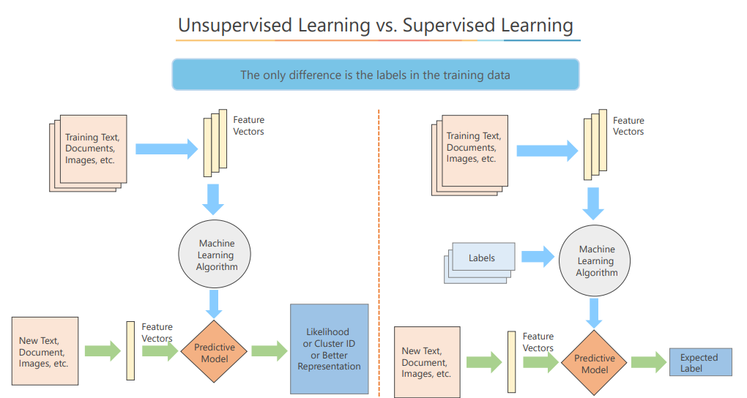

Slide 10
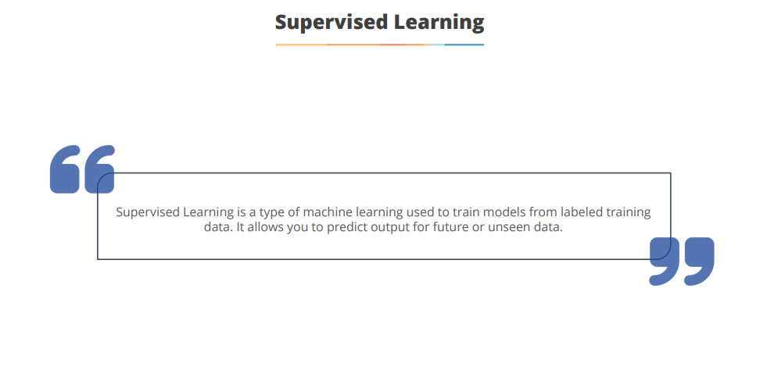

Slide 11
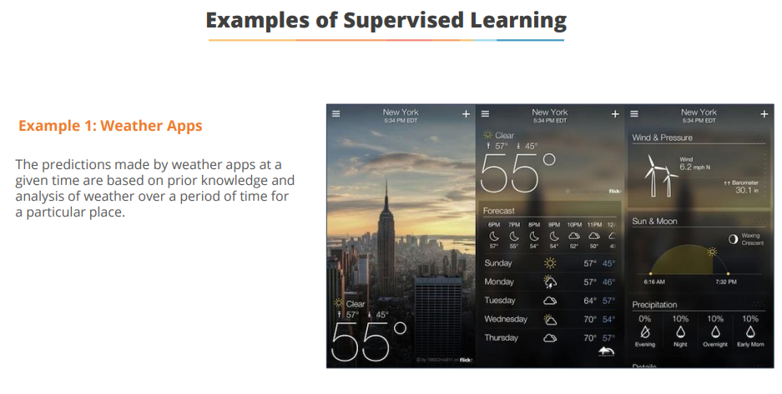

Slide 12
 | age | time_spent | pages_viewed | clicks | sentiment_score | engagement_score | survey_response
0 | 56 | 6.024771 | 16 | 2 | -0.848946 | 7.809908 | 0
1 | 46 | 13.219156 | 3 | 12 | 0.655162 | 9.787663 | 0
2 | 32 | 13.141028 | 10 | 6 | -0.144662 | 10.056411 | 0
3 | 60 | 9.114213 | 6 | 13 | 0.192128 | 9.345685 | 0
4 | 25 | 10.050655 | 18 | 10 | -0.820696 | 12.420262 | 1

Slide 13
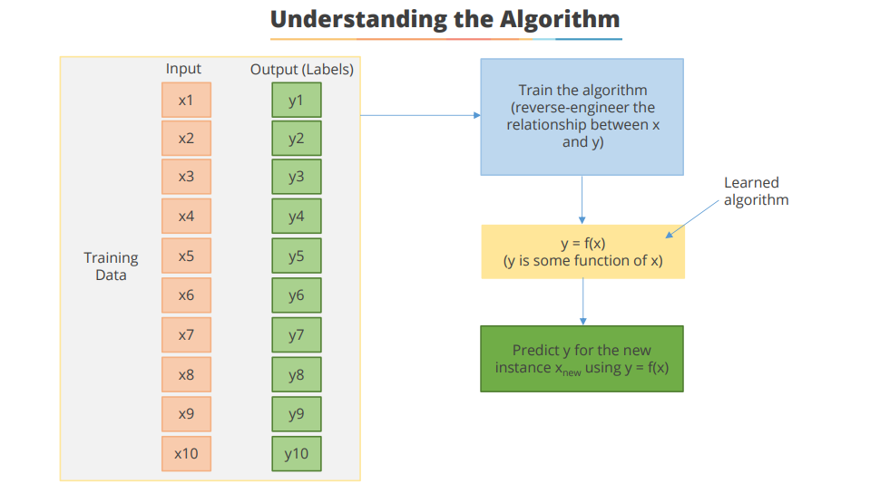

Slide 14
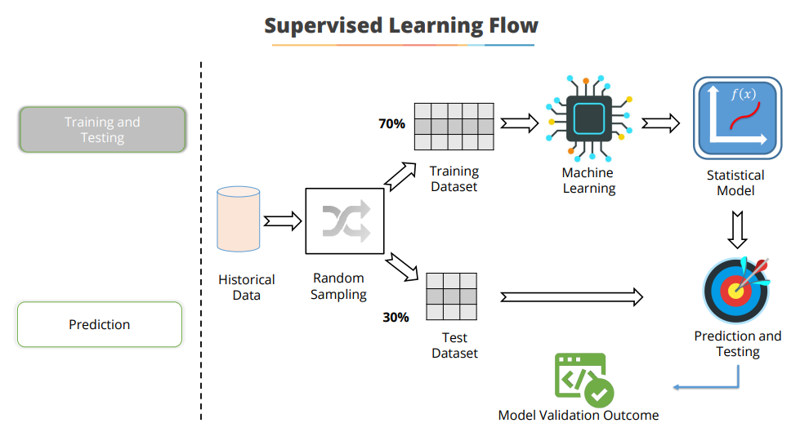

Slide 15
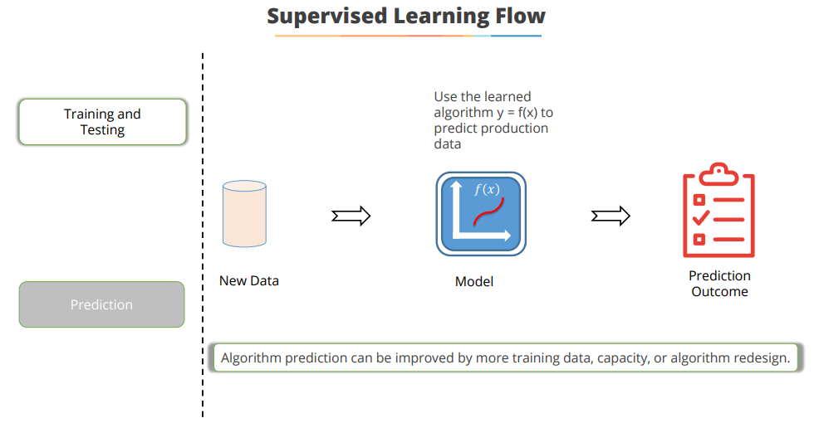

Slide 16
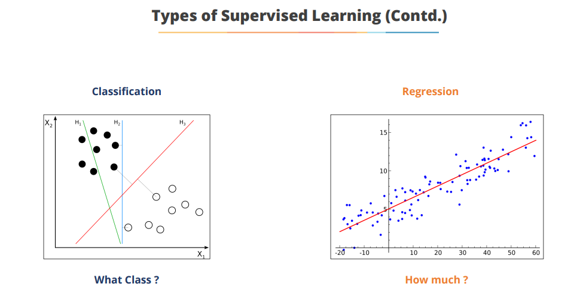

Slide 17
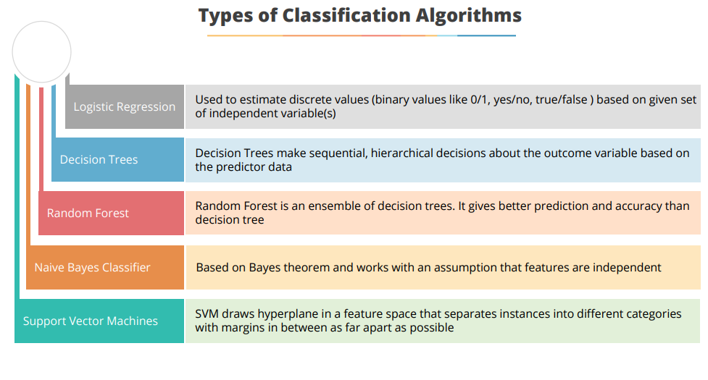

Slide 18
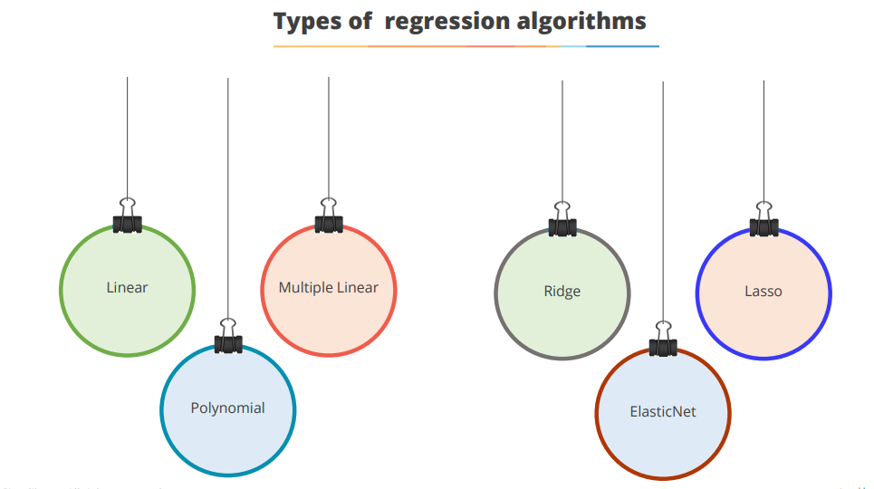

Slide 19
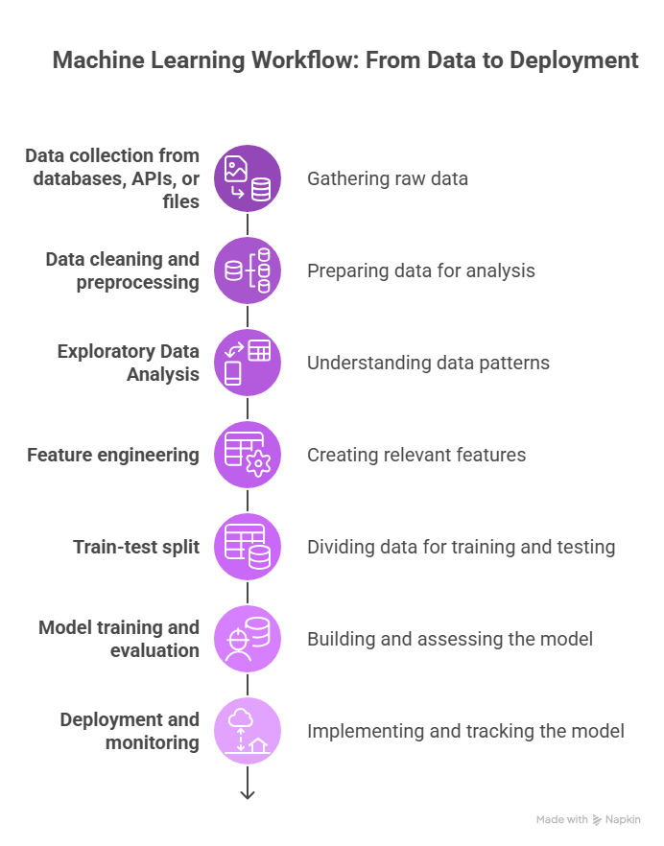

Slide 20
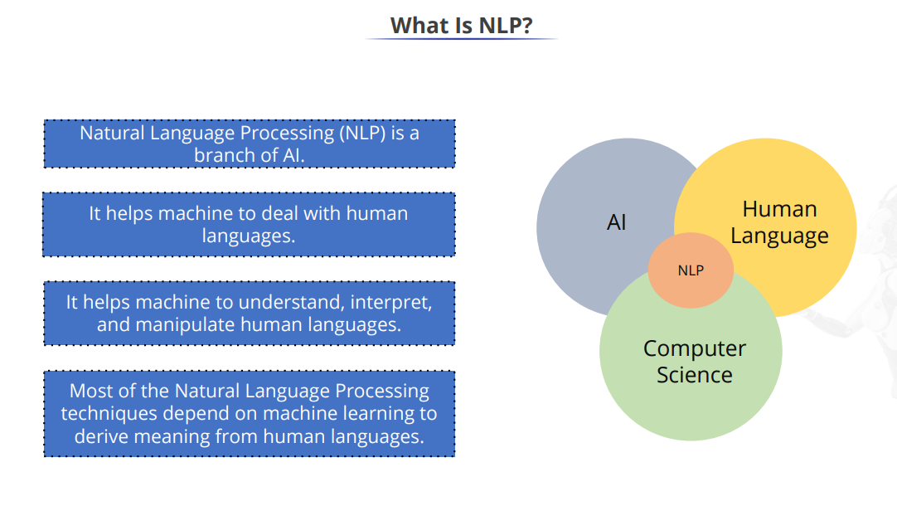

Slide 21
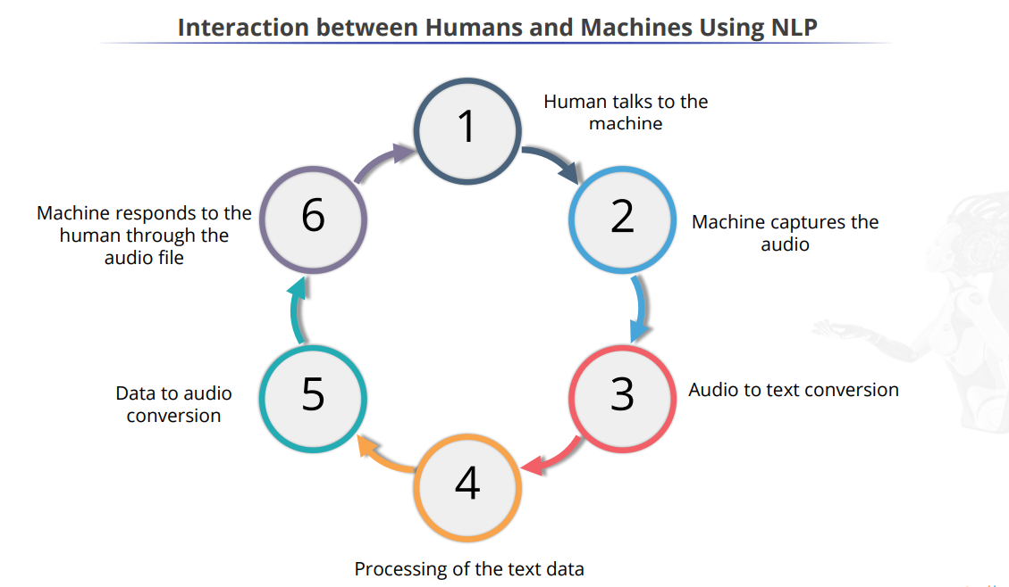

Slide 22
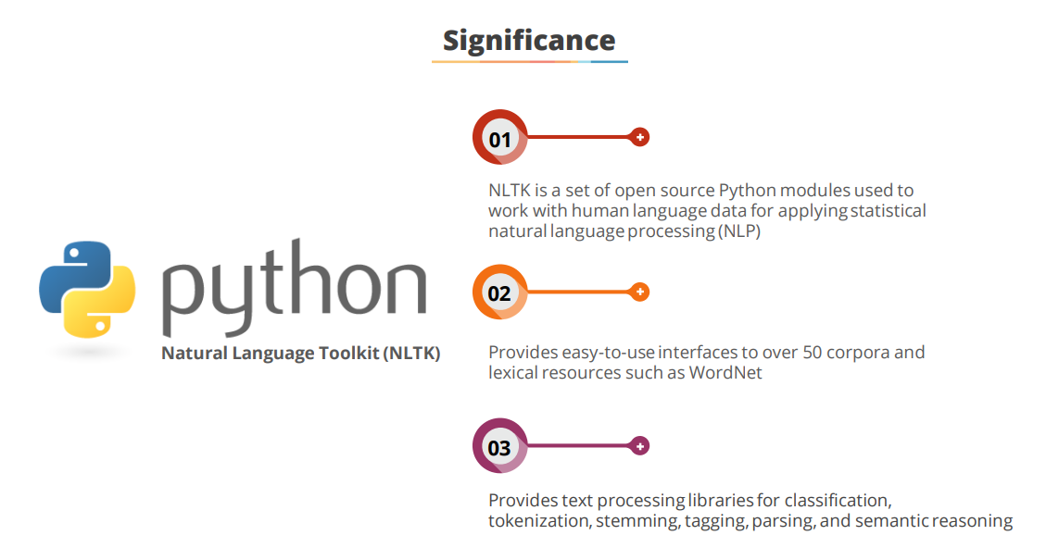

Slide 23
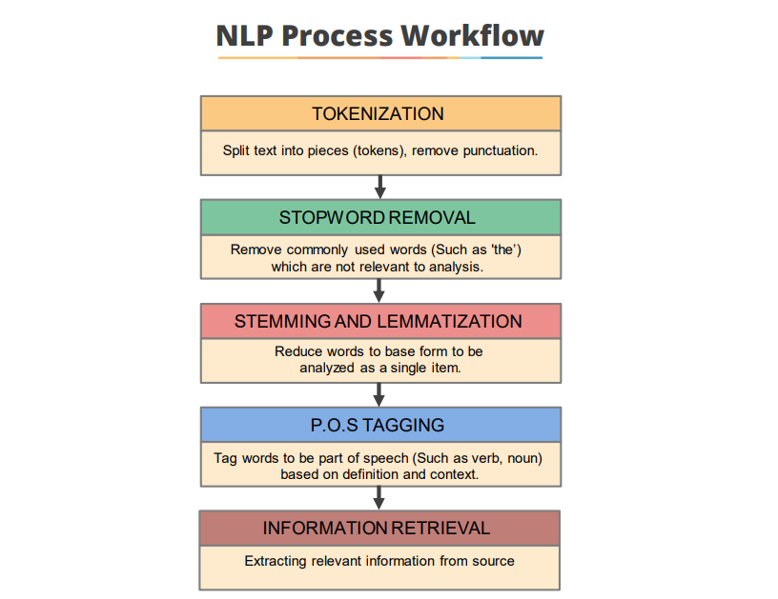

Slide 24
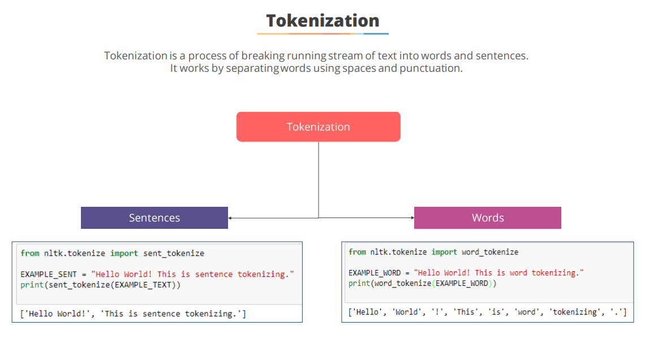

Slide 25
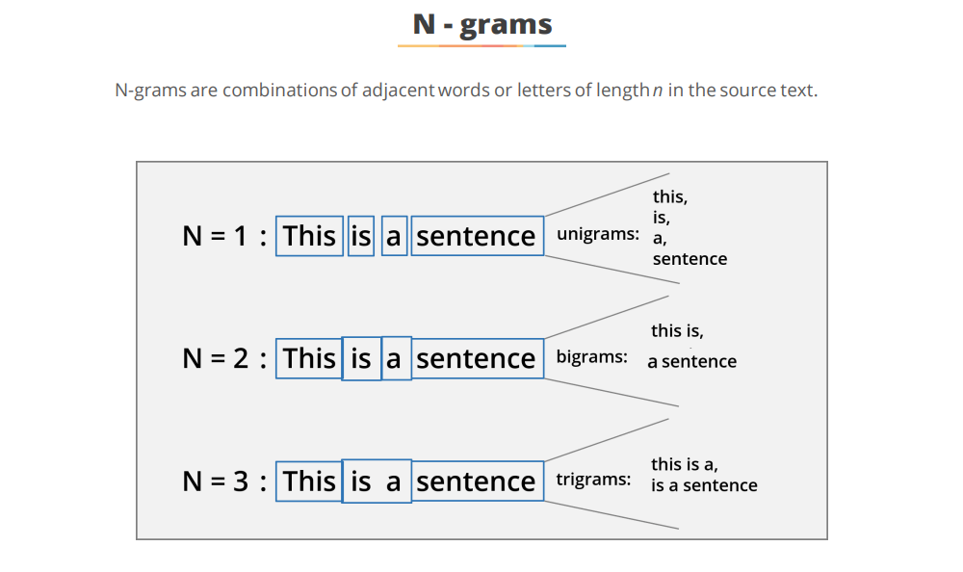

Slide 26
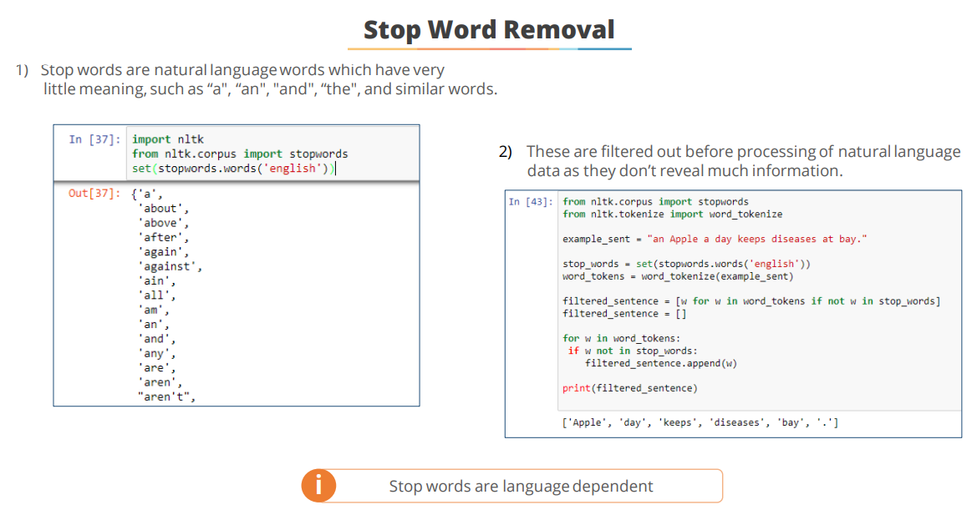

Slide 27
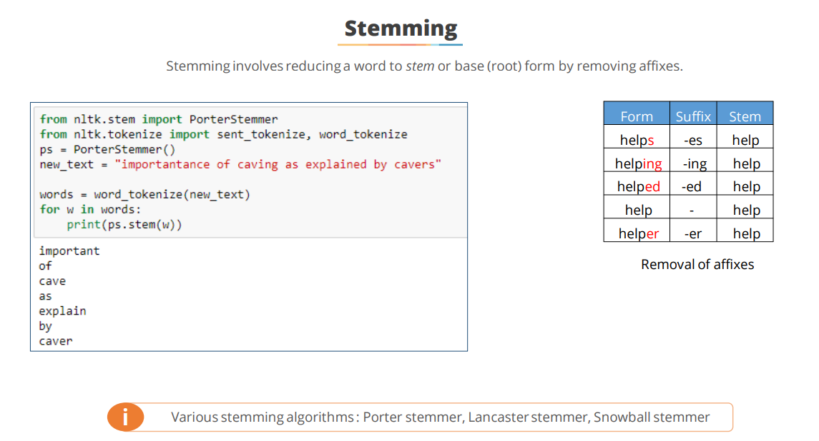

Slide 28
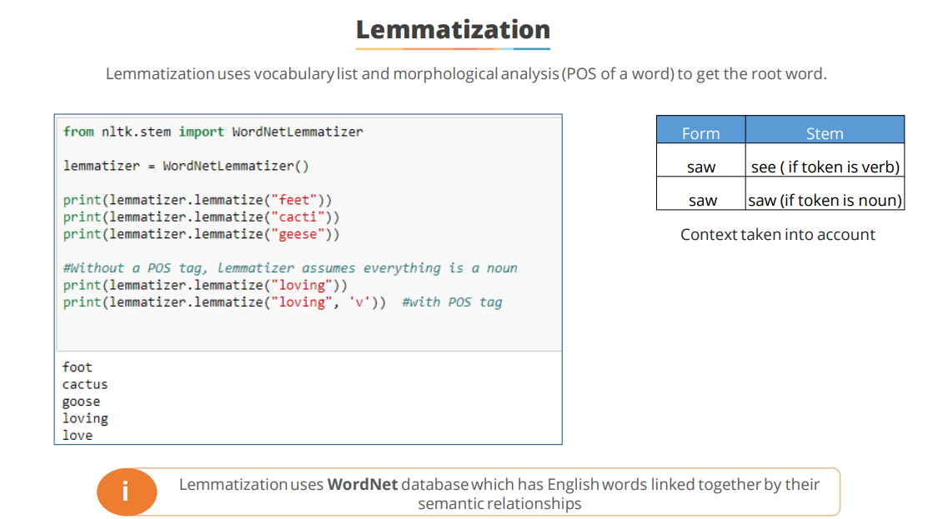

Slide 29
